Slide 1
Kernel Methods
TexPoint fonts used in EMF.
Read the TexPoint manual before you delete this box.: AAAAAAAAA

Slide 2
Announcements
HW3 due today, HW4 assigned

Slide 3
Outline
Nonlinear classification and regression via nonlinear feature maps
Kernels
Kernel Methods

Slide 4
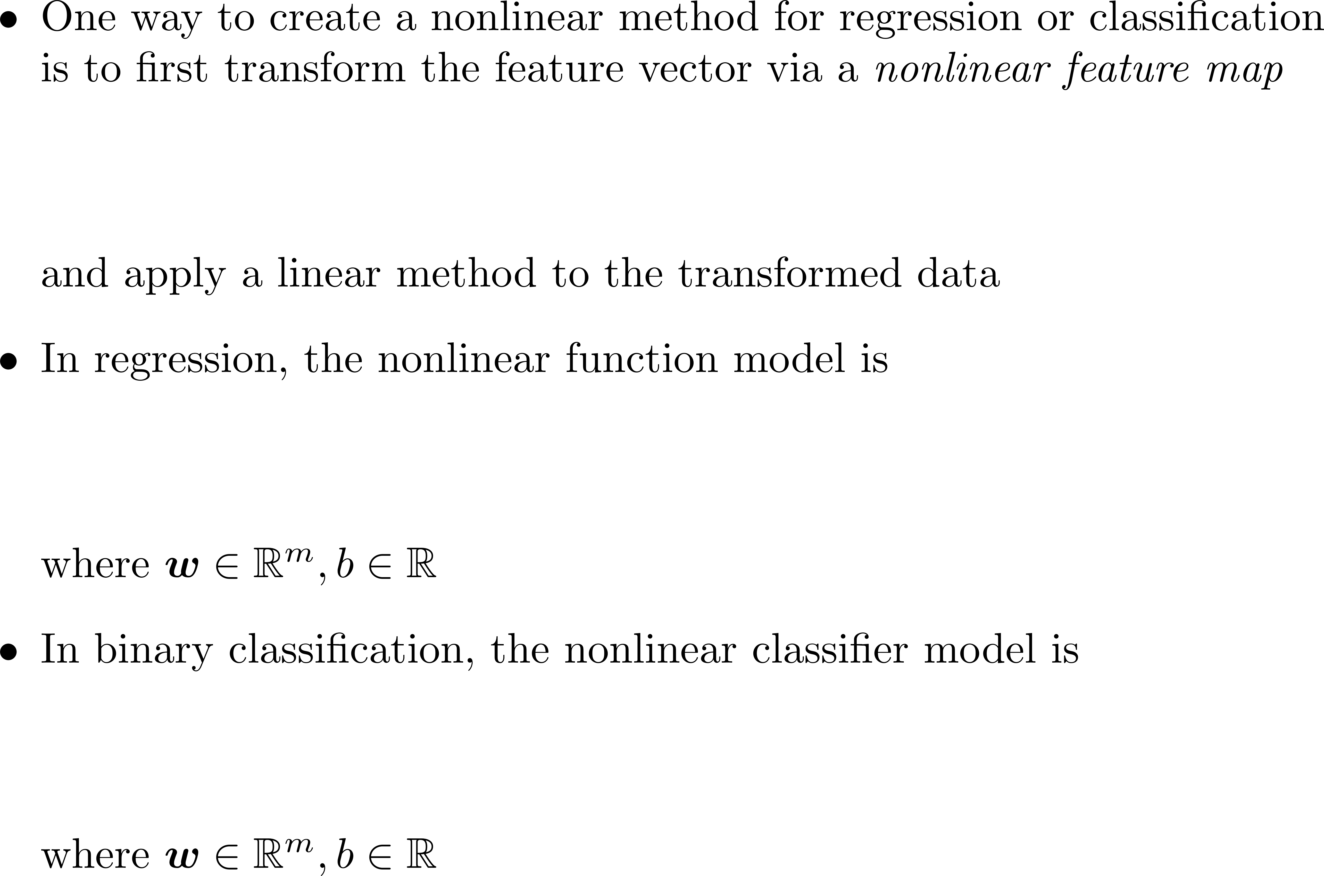
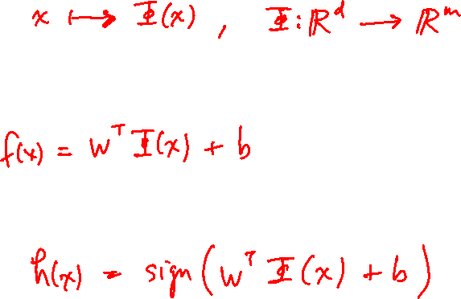
Nonlinear Feature Maps

Slide 5
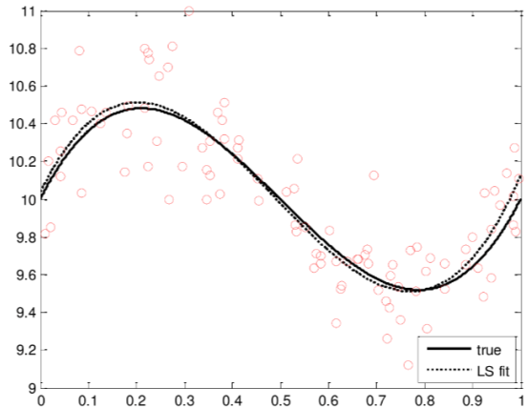
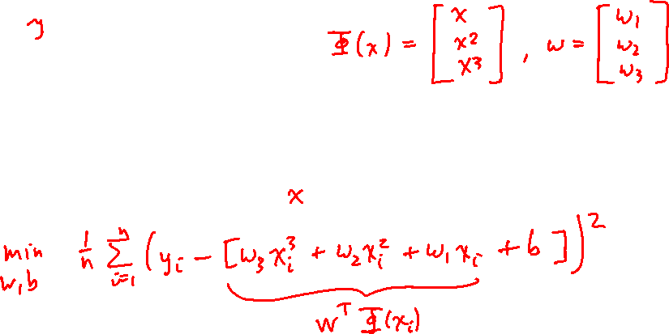
Nonlinear Feature Maps

Slide 6
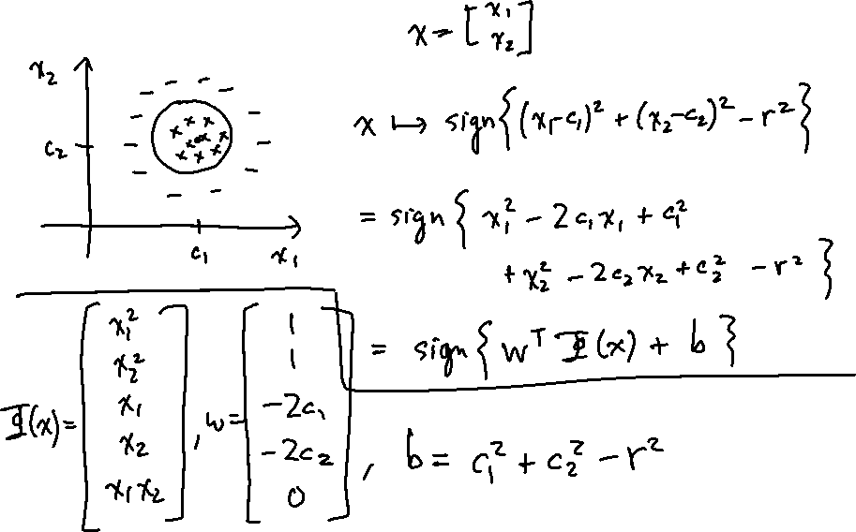
Nonlinear Feature Maps

Slide 7
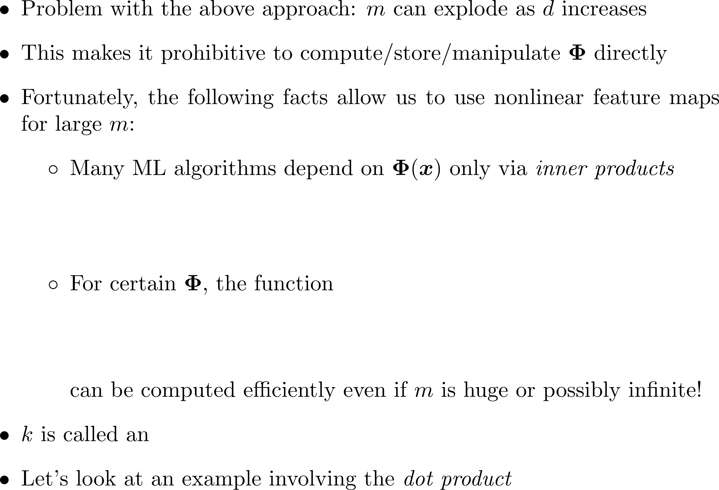
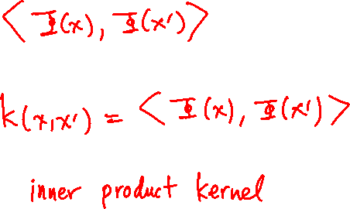
Inner Product Kernels

Slide 8
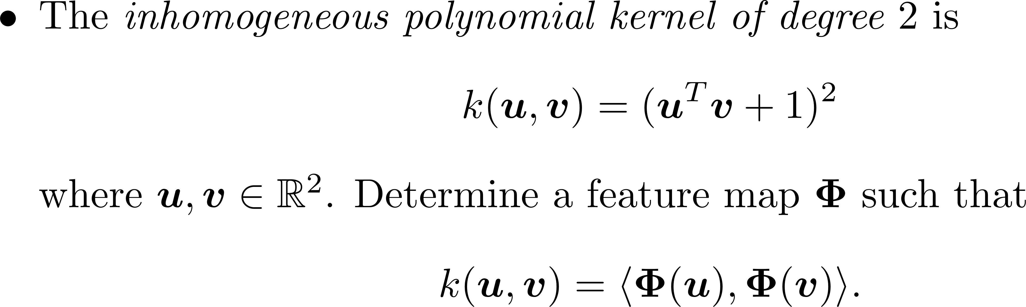
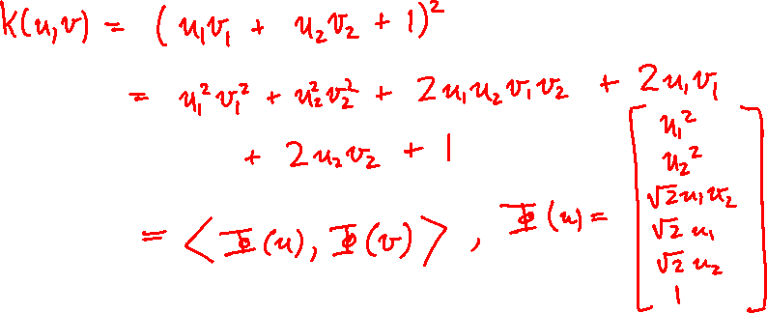
Example

Slide 9
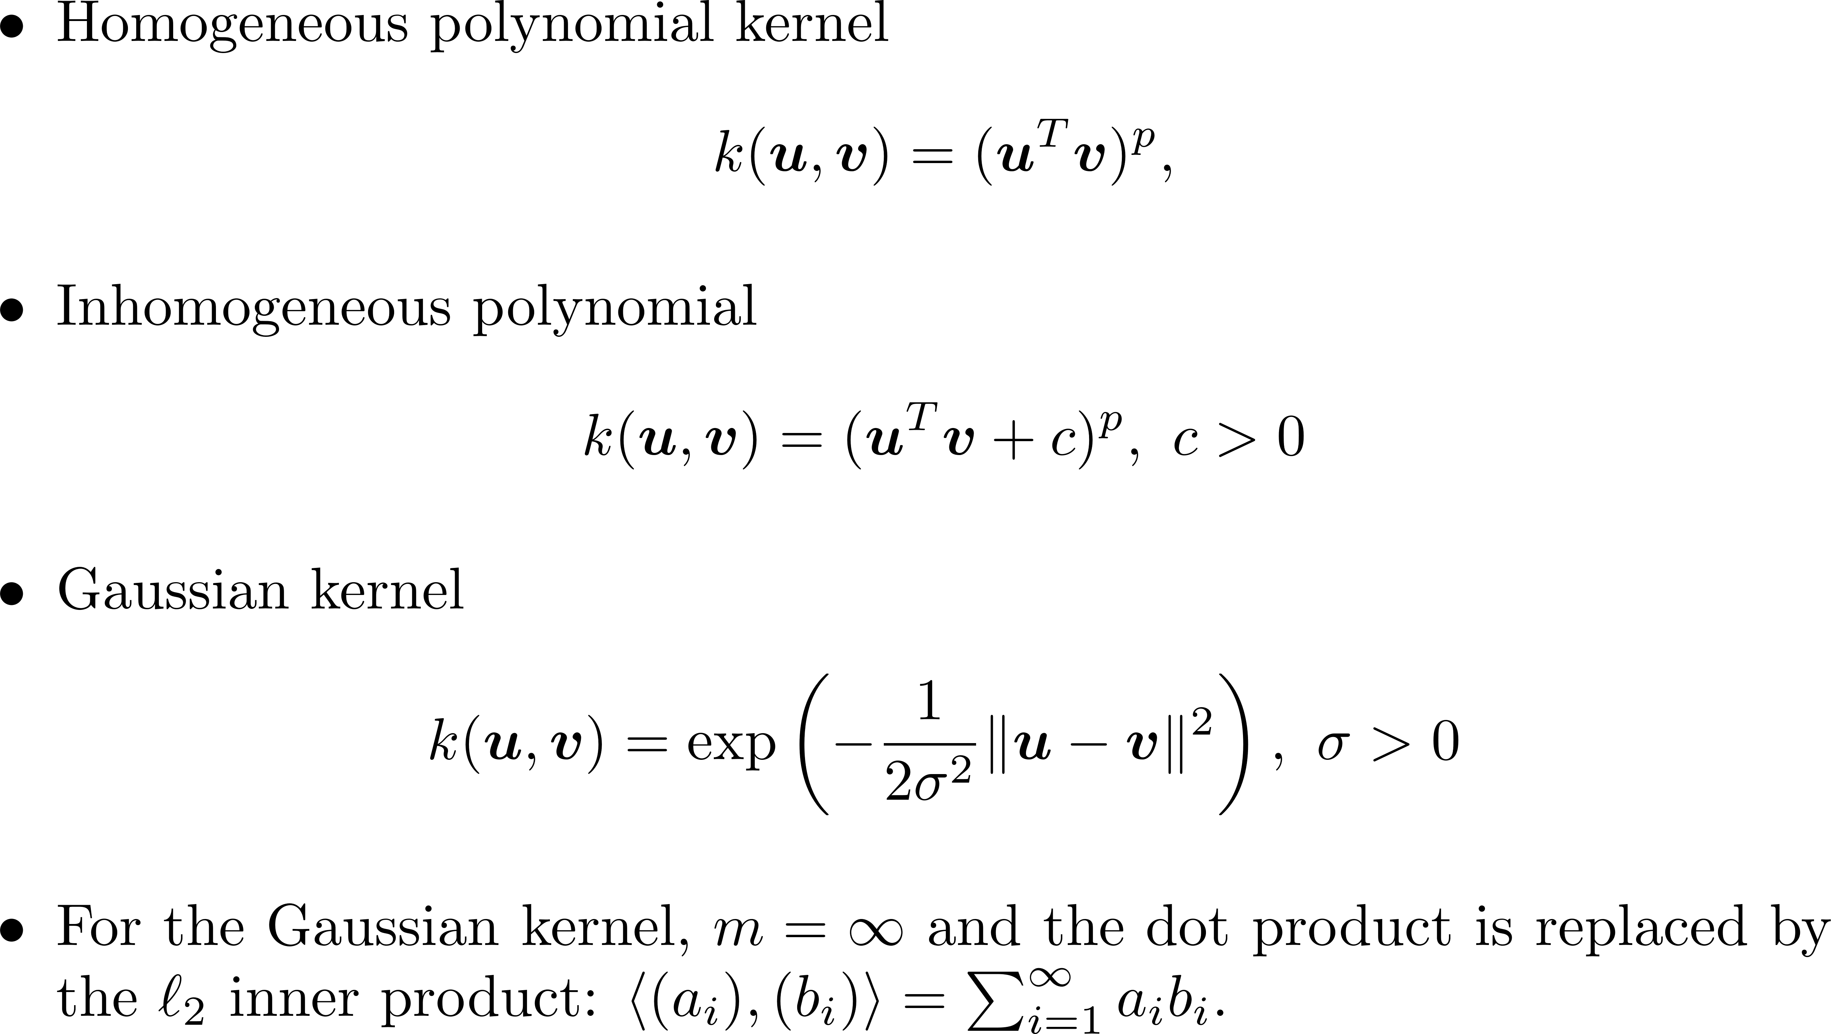
Important Kernels

Slide 10
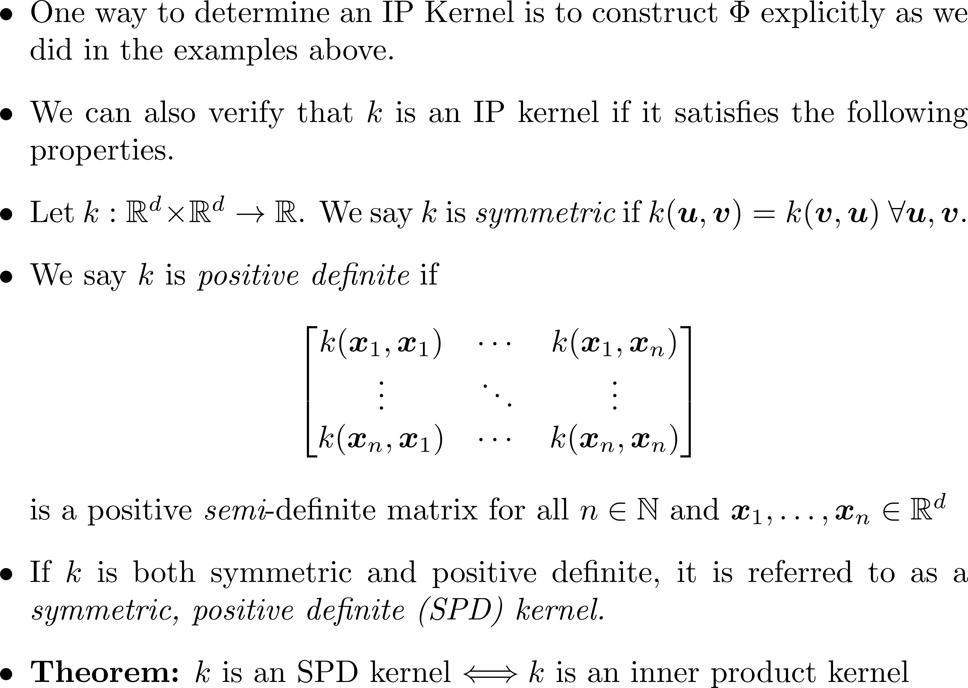
SPD Kernels

Slide 11
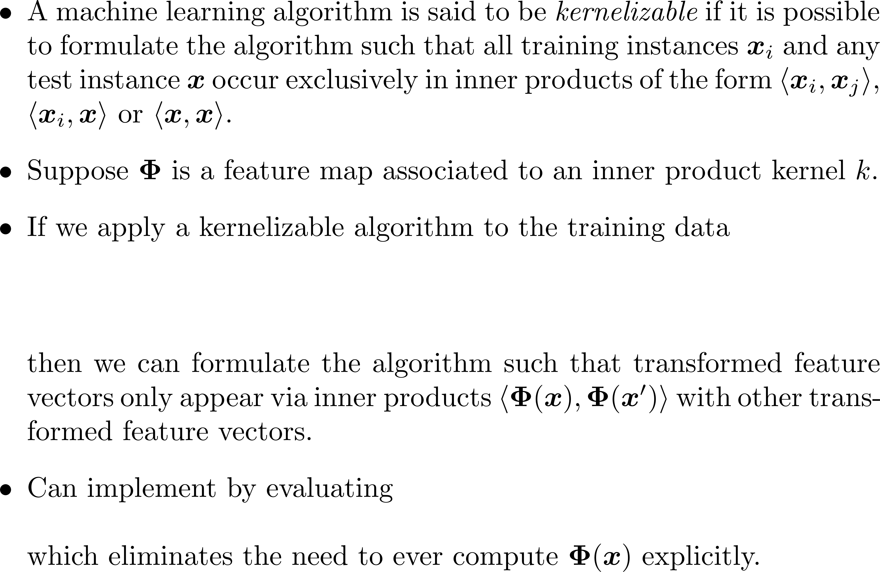
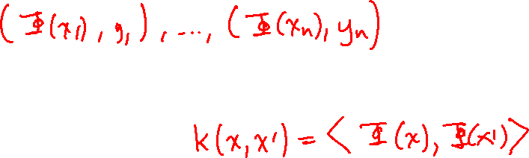
The Kernel Trick

Slide 12
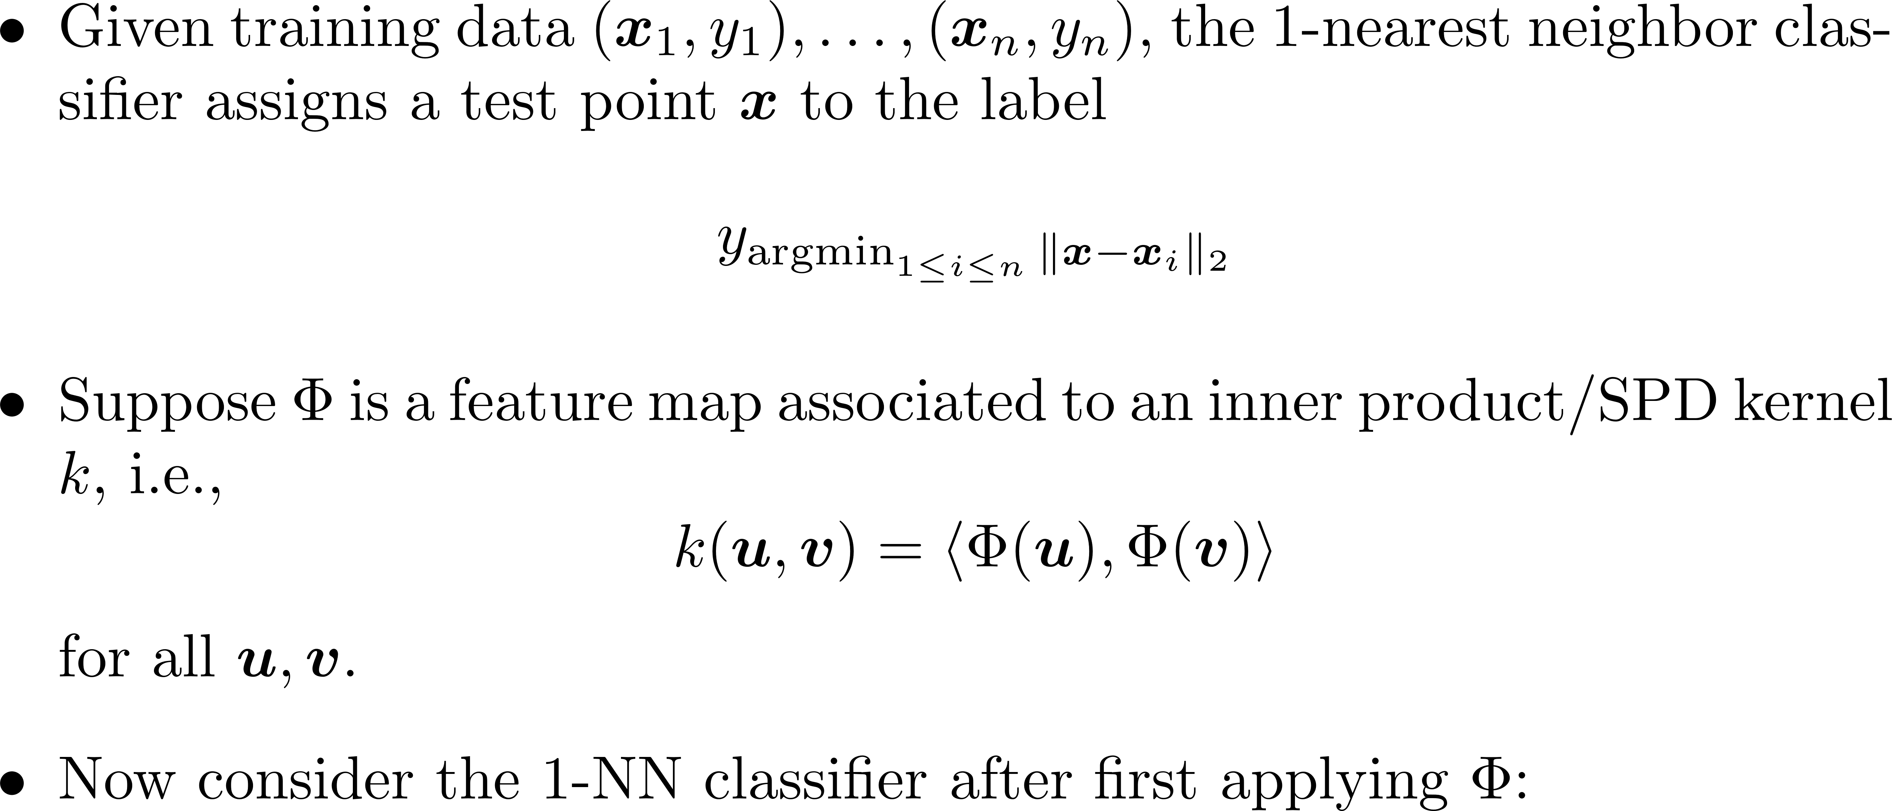
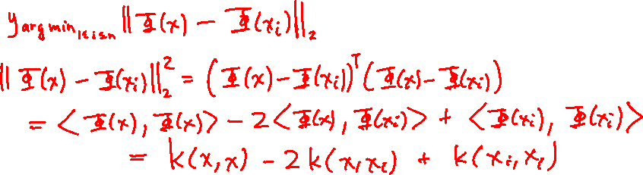
Example: Nearest Neighbors

Slide 13
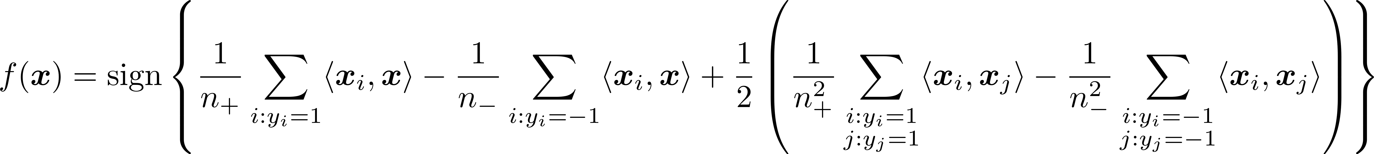
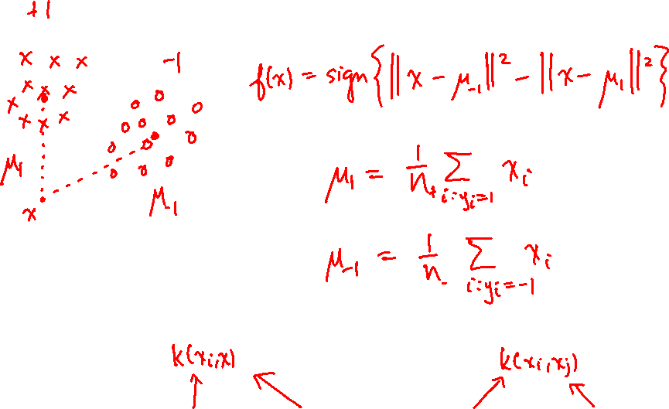
Nearest Centroid Classifier

Slide 14
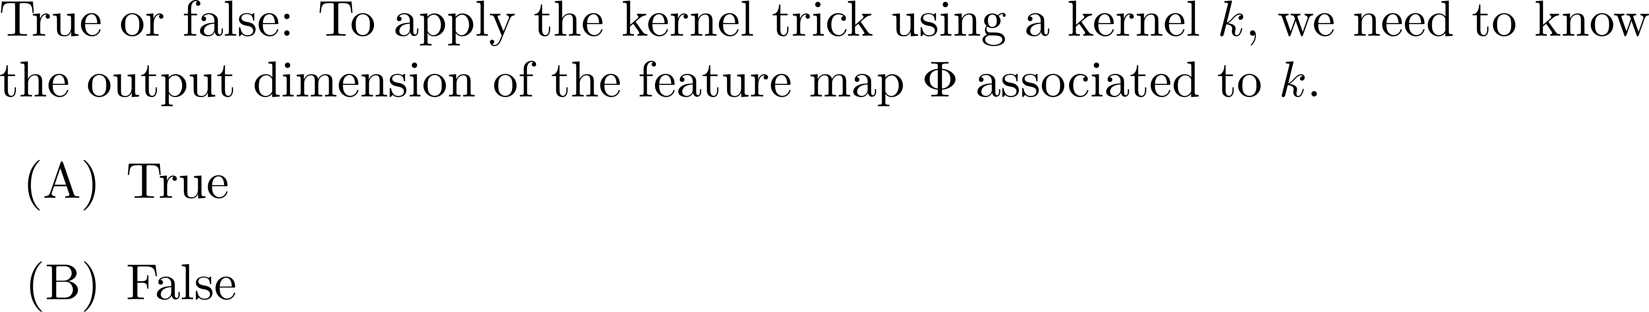
Poll

Slide 15
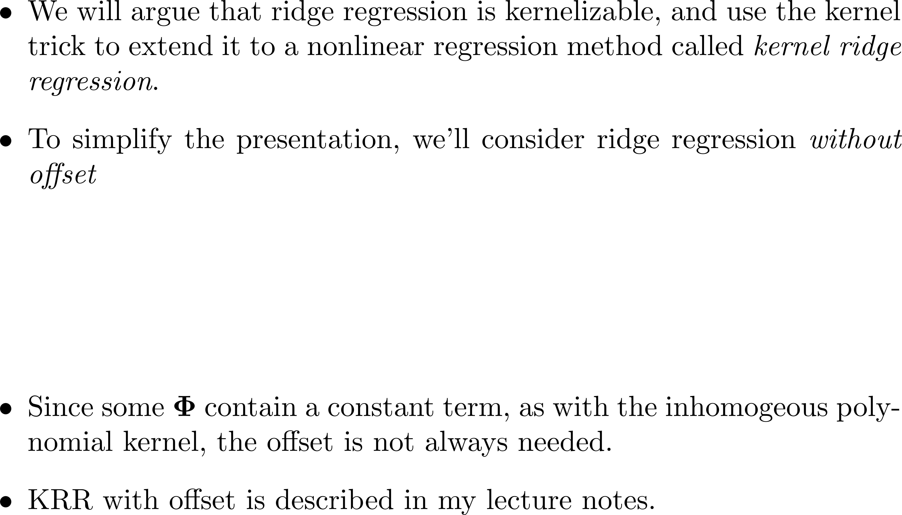
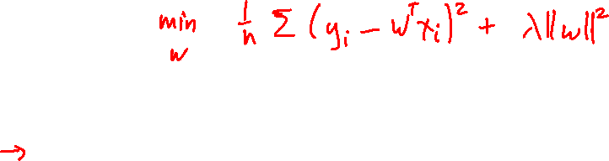
Kernel Ridge Regression

Slide 16
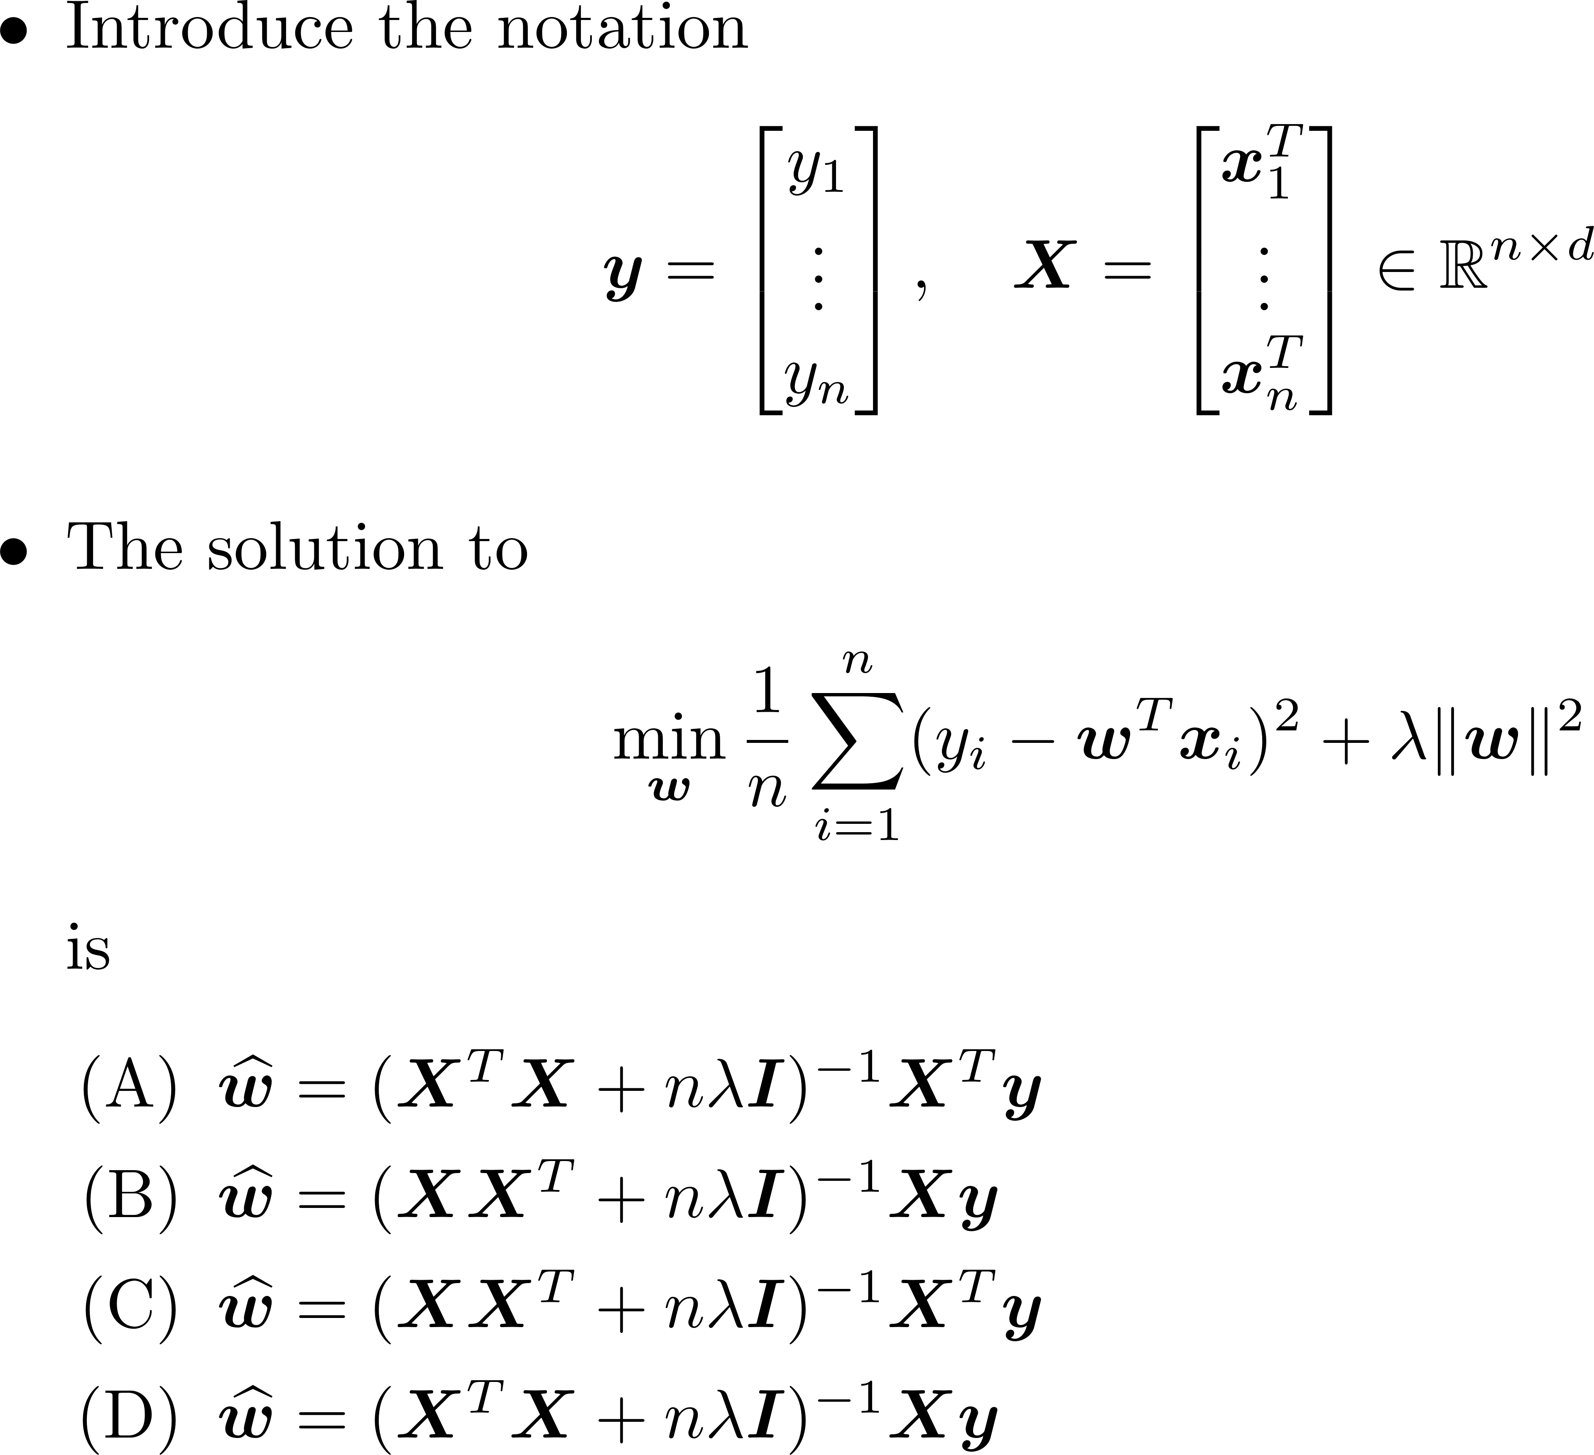

Poll

Slide 17
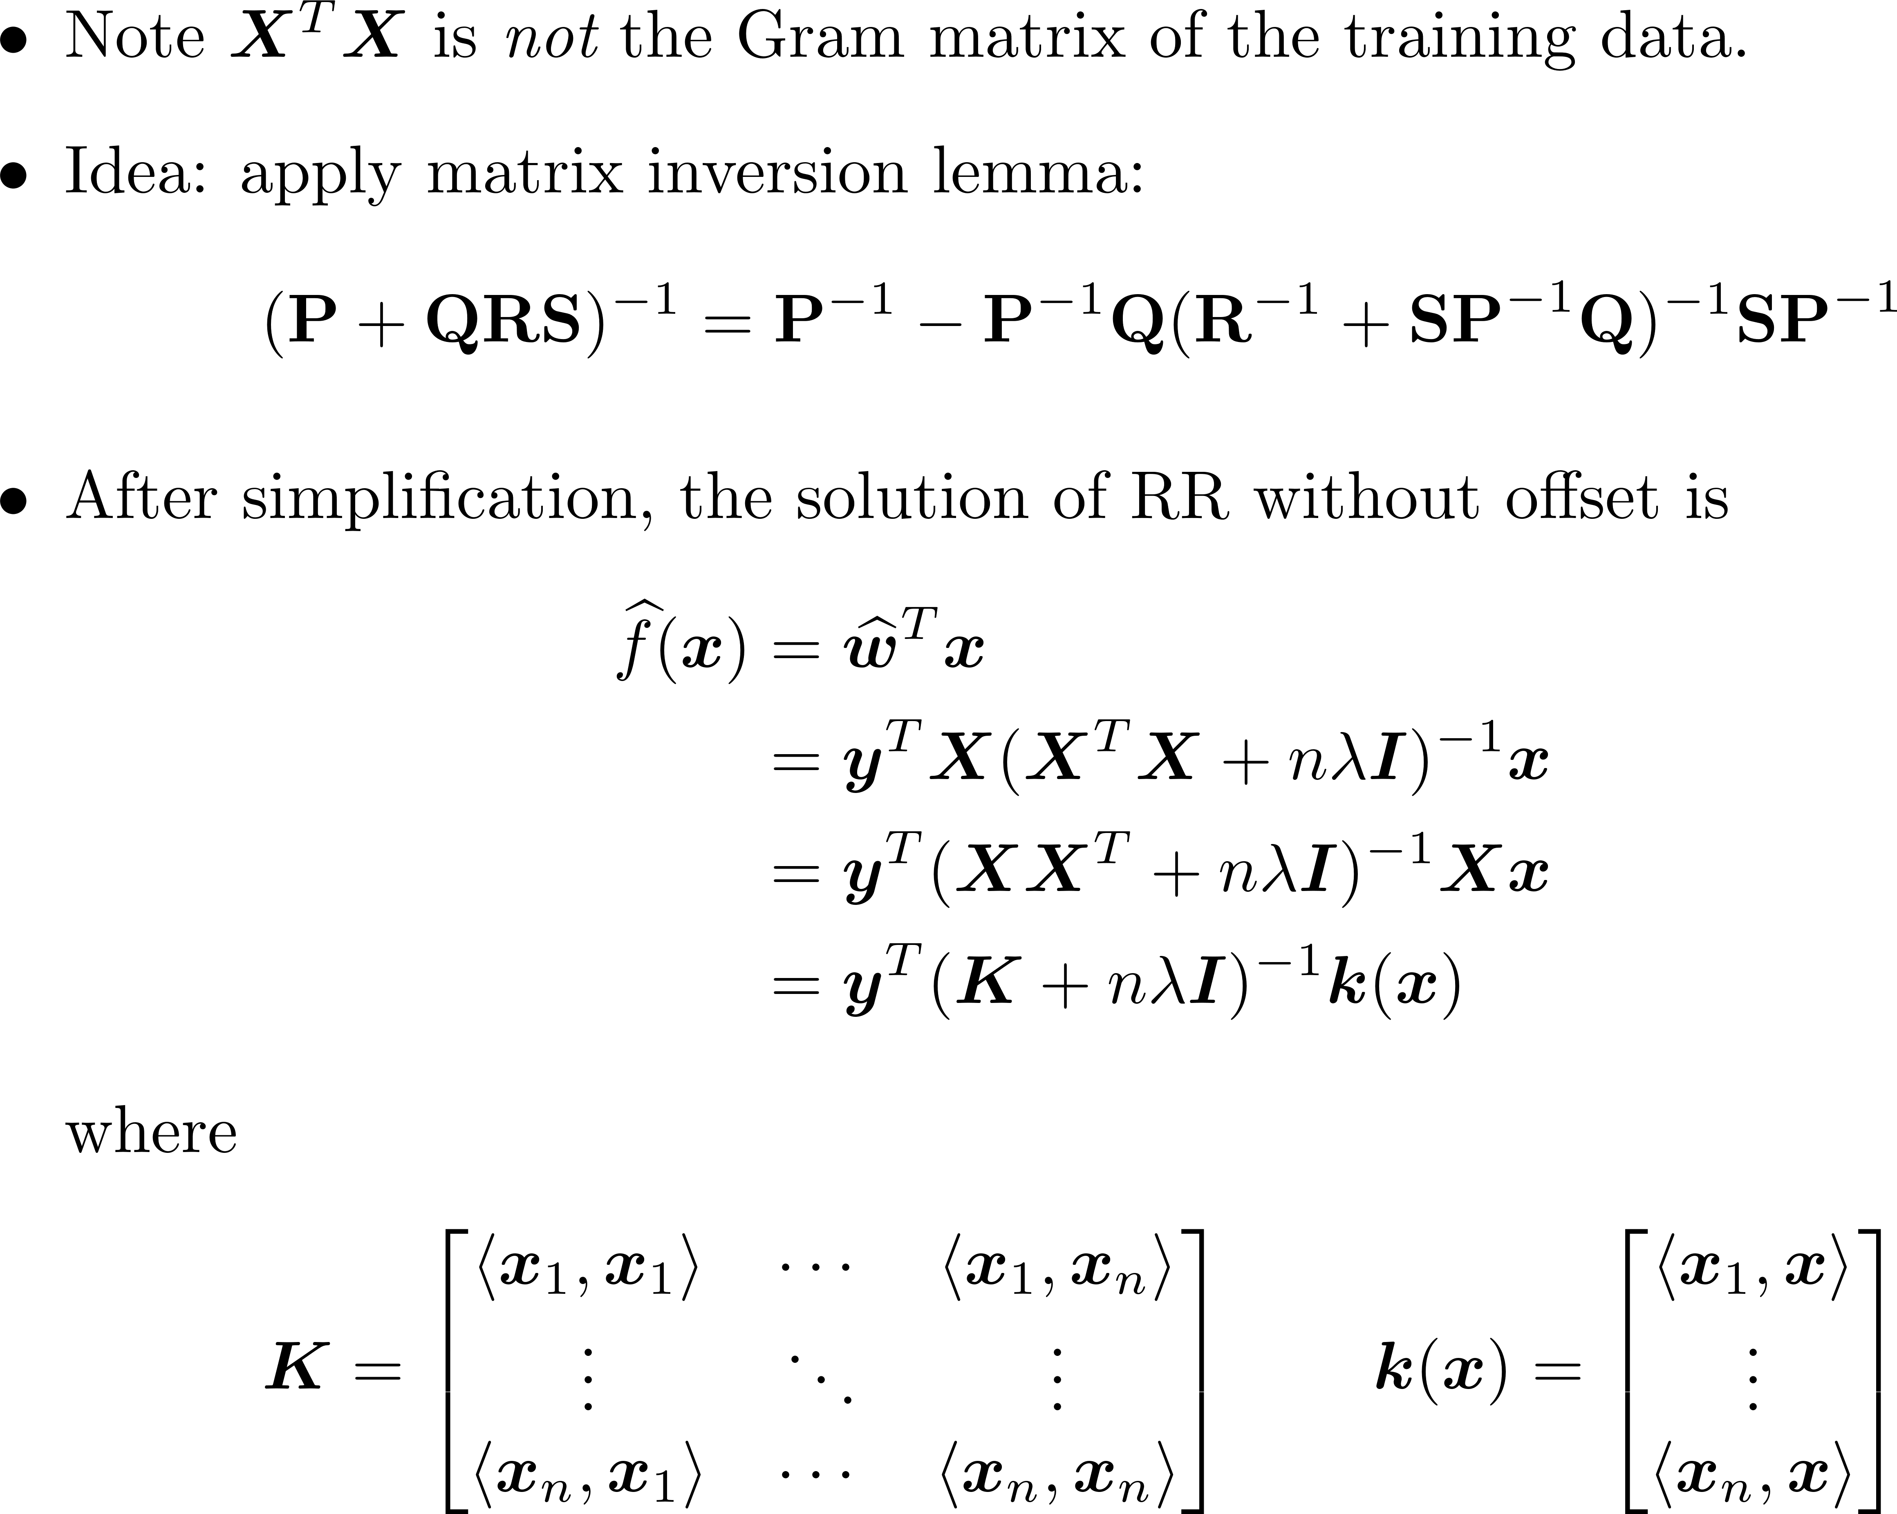

Kernel Ridge Regression

Slide 18
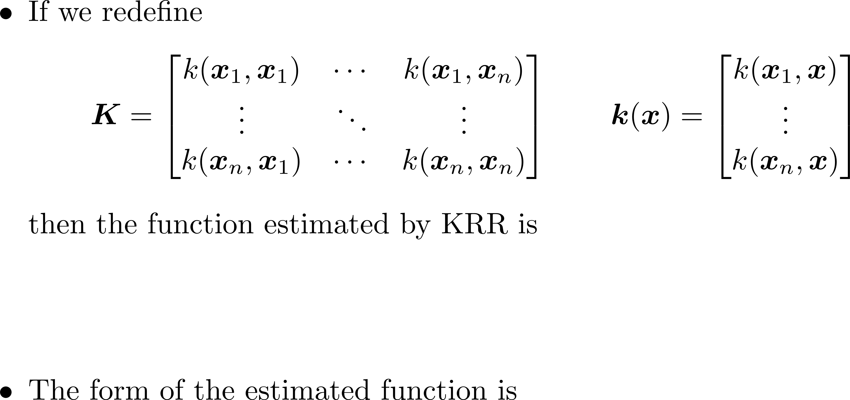
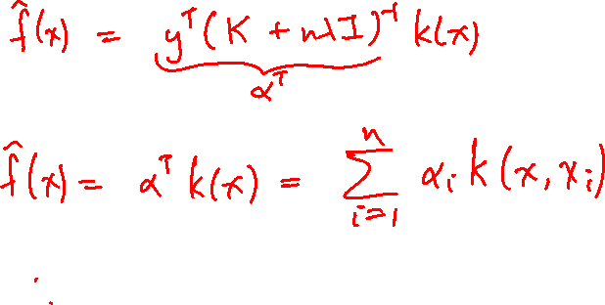
Kernel Ridge Regression

Slide 19
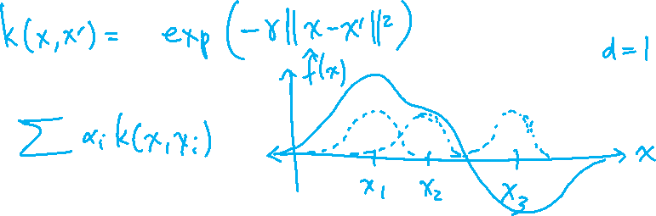
Summary
Kernels: Convenient way to incorporate nonlinear feature maps into an algorithm
Kernel ridge regression: powerful nonlinear regression method, useful element of the ML toolbox
See lecture notes for KRR with offset
Neural tangent kernel: interesting connections to neural networks
Next two lectures: We will kernelize the optimal soft-margin hyperplane classifier, leading to the support vector machine

